Slide 1
CSS Pre-Processors

Slide 2
WHY?
DRY(don’t repeat yourself)

Slide 3



There are many options for CSS preprocessors:

Slide 4
http://www.sassmeister.com/
Paste sass and sassmeister will converit it to css

Slide 5
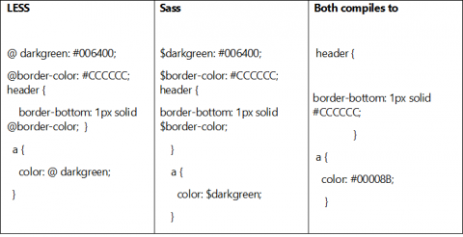
https://www.hcltech.com/blogs/classy-way-using-css-through-css-preprocessor

Slide 6
Sass: Syntactically Awesome Style Sheets
Sass is the most mature, stable, and powerful professional grade CSS extension language in the world.

Slide 7
Sass has two syntaxes
SCSS
.scss file extension
Uses brackets and semicolons
Sass
.sass file extension
Uses only visual hierarchy- no brackets or semicolons
They can be used together and both are easily converted to the other.

Slide 8
Use your Sass
Install Ruby
Install Sass gem: gem install sass
Run Sass: sass input.scss output.css
Watch Sass: sass –watch input.css:output.css *optional

Slide 9
Variables
CSS:
background-color: #838487
Sass:
$any-name-you-can-think-of: #838487
background-color: $any-name-you-can-think-of

Slide 10
Mixins
@mixin boring-text
color: black
font-family: "Times New Roman", Times, serif
body
@include boring-text
They’re often included in a separate file.

Slide 11
Nesting and parent selectors (&)
body
color: #17202A
h1
&:hover
color: #7D3C98
Here’s the sass:

Slide 12
Nesting and parent selectors (&)
body {
background-color: #CB4335;
color: #17202A;
padding: 10px; }
body h1:hover {
color: #7D3C98; }
Same code, compiled to CSS

Slide 13
Command line errors
>>> Change detected to: style.sass
error style.sass (Line 55: Invalid CSS after "50px": expected expression (e.g. 1px, bold), was ";")
I added a semicolon

Slide 14
@import and partials
This goes at the top of your sass file:
@import ‘filelocation/filename’
File name must be preceded by an underscore

Slide 15
Want more?
Sass: http://sass-lang.com/guide
LESS: http://lesscss.org/#
stylus: http://stylus-lang.com/

